Slide 1


Ribonucleic acid (RNA)
Lecture 9
Dr. Rawa Abdul Redha Aziz
Ph.D Antibiotics/ Molecular biology

Slide 2
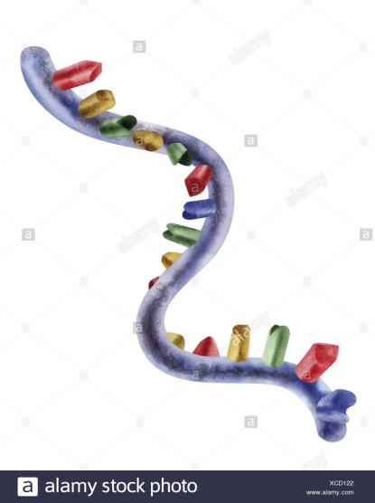
Introduction
It is a polymeric molecule essential in various biological roles in coding, decoding, regulation and expression of genes. RNA and DNA are nucleic acids, and, along with lipids, proteins and carbohydrates, constitute the four major macromolecules essential for all known forms of life.
Like DNA, RNA is assembled as a chain of nucleotides, but unlike DNA it is more often found in nature as a single-strand folded onto itself, rather than a paired double-strand.

Slide 3
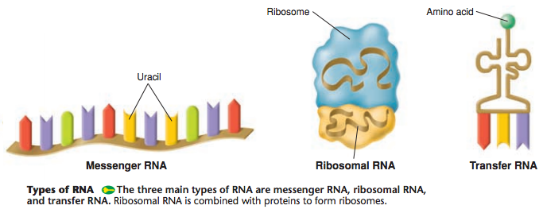
RNA and its types

Slide 4
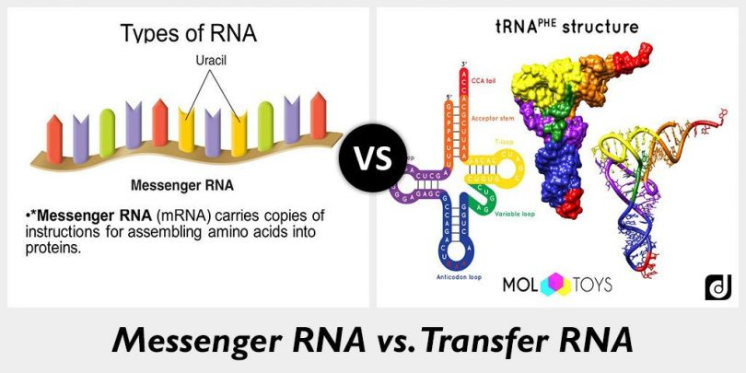
Messenger RNA (mRNA)
It is a large family of RNA molecules that convey genetic information from DNA to the ribosome, where they specify the amino acid sequence of the protein products of gene expression. RNA polymerase transcribes primary transcript mRNA (known as pre-mRNA) into processed, mature mRNA. This mature mRNA is then translated into a polymer of amino acids: a protein through translation process

Slide 5
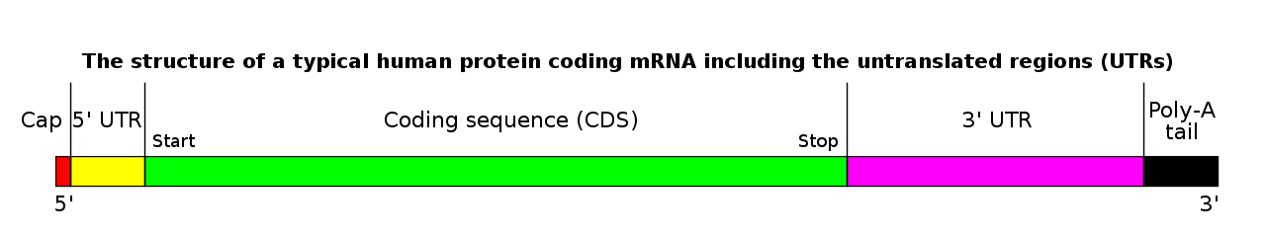
The structure of a mature eukaryotic mRNA

Slide 6
Monocistronic versus polycistronic mRNA
An mRNA molecule is said to be monocistronic when it contains the genetic information to translate only a single protein chain (polypeptide). This is the case for most of the eukaryotic mRNAs. On the other hand, polycistronic mRNA carries several open reading frames (ORFs), each of which is translated into a polypeptide. These polypeptides usually have a related function and their coding sequence is grouped and regulated together in a regulatory region, containing a promoter and an operator. Most of the mRNA found in bacteria and archaea is polycistronic as is the human mitochondrial genome. Dicistronic or bicistronic mRNA encodes only two proteins.

Slide 7
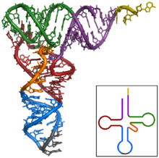
2-Transfer RNA (tRNA)
It is an adaptor molecule composed of RNA, typically 76 to 90 nucleotides in length, that serves as the physical link between the mRNA and the amino acid sequence of proteins. tRNA does this by carrying an amino acid to the protein synthetic machinery of a cell (ribosome) as directed by a 3-nucleotide sequence (codon) in a messenger RNA (mRNA). As such, tRNAs are a necessary component of translation, the biological synthesis of new proteins in accordance with the genetic code

Slide 8
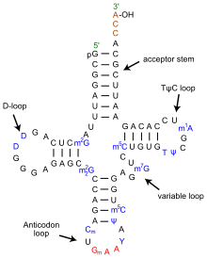
Structure of tRNA

Slide 9
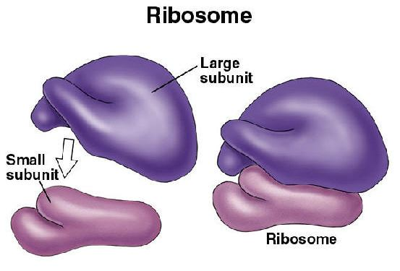
3-Ribosomal RNA (rRNA)
The P site holds the tRNA that carries the growing polypeptide chain
– The A site holds the tRNA that carries the next amino acid to be added to the chain
– The E site is the exit site, where discharged tRNAs leave the ribosome.

Slide 10
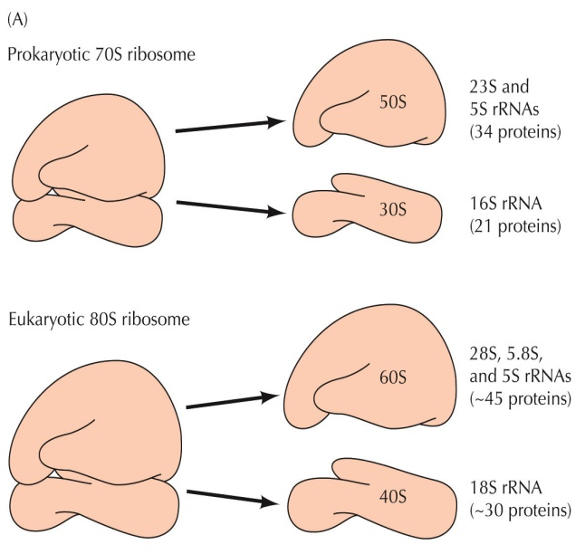

Slide 11
Subunits and ribosomal RNA genes
Type | Size | Large subunit (LSU rRNA) | Small subunit (SSU rRNA)
prokaryotic | 70S | 50S (5S : 120 nt, 23S : 2906 nt) | 30S (16S : 1542 nt)
eukaryotic | 80S | 60S (5S : 121 nt, 5.8S : 156 nt, 28S : 5070 nt) | 40S (18S : 1869 nt)

Slide 12
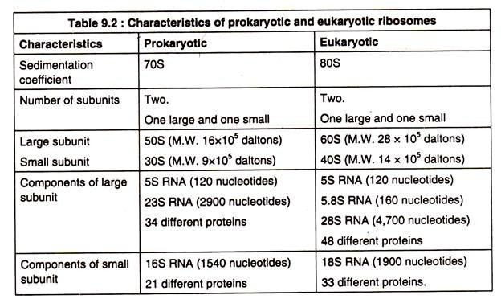
Shine-Dalgarno (SD) Sequence

Slide 13


